Slide 1

영어 말하기
20502 고승원
ALLPPT.com _ Free PowerPoint Templates, Diagrams and Charts

Slide 2
Contents
Product description
Advantages of the product

Slide 3
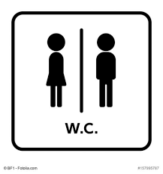
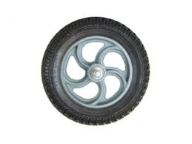
1)Product description
You can use the Application that Toilet moves on the
Place.

Slide 4
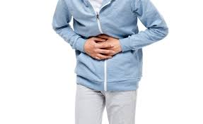

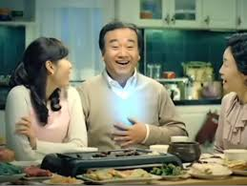
2)Product Advantages
1) Quick to use toilet
When you want go to toilet hurry, It is possible for this toilet to arrive fast to where the user is.

Slide 5
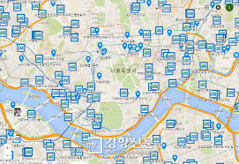
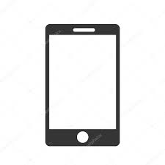

2)Product Advantages
2)Conveniention
: ? peaple
You can get fast and convenience search to information to toilet

Slide 6

Question time

Slide 7
Thack you for warch.

